Slide 1
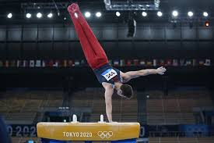
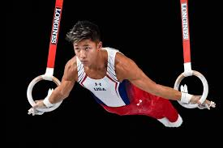
Injury Prevention & Management for Boys High School Gymnastics
PRESENTED BY RACHEL QUICK, PT, DPT, OCS

Slide 2
Objectives
Discuss challenges of high school gymnastics season
Identify common acute and chronic injuries
Learn basic injury management tips
Learn how to incorporate injury prevention into preseason and into your practices
Learn key exercises to include in your warm-up and in your conditioning

Slide 3
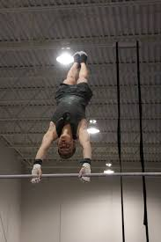
Beginning of Season Challenges
Individual fitness levels
Club gymnastics training
Participation in other sports
New skills in different environment
Pre-existing injuries
First time gymnastics participant
Notes:
<number>

Slide 4
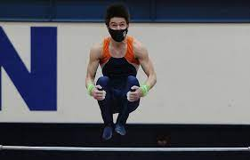
Mid-Season Challenges
Several meets per week
Meets following full day of school
Variations in equipment/mats
All-around vs. event specialist
Access to athletic trainers/medical staff
Difficult to fit practice, competition and conditioning into limited time
Notes:
<number>

Slide 5
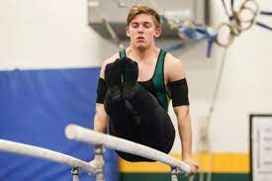
End of Season Challenges
“Pushing through the pain” to compete at regionals, sectionals, and state
When should your gymnast seek medical attention?
Who should manage medical care?
Notes:
<number>

Slide 6
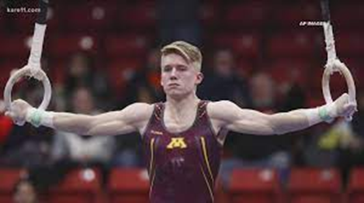
Common Gymnastics Injuries
Acute
1 episode
Usually traumatic
Examples: Fracture, tendon or ligament tear
Chronic
Pain that persists for 2-3 months
Pain starts after activity, eventually starts to limit activity
Examples: Patellar tendinitis, shoulder instability

Slide 7
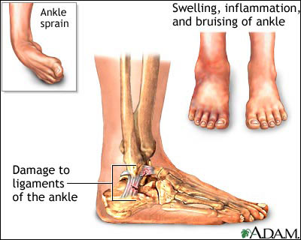
Acute Injuries in Gymnasts
Lateral Ankle Sprain
Common mechanism: Excessive inversion and plantar flexion
Common complaint: “Turned in or rolled in”
Grade I-III in severity
May need x-ray to rule out a fracture

Slide 8
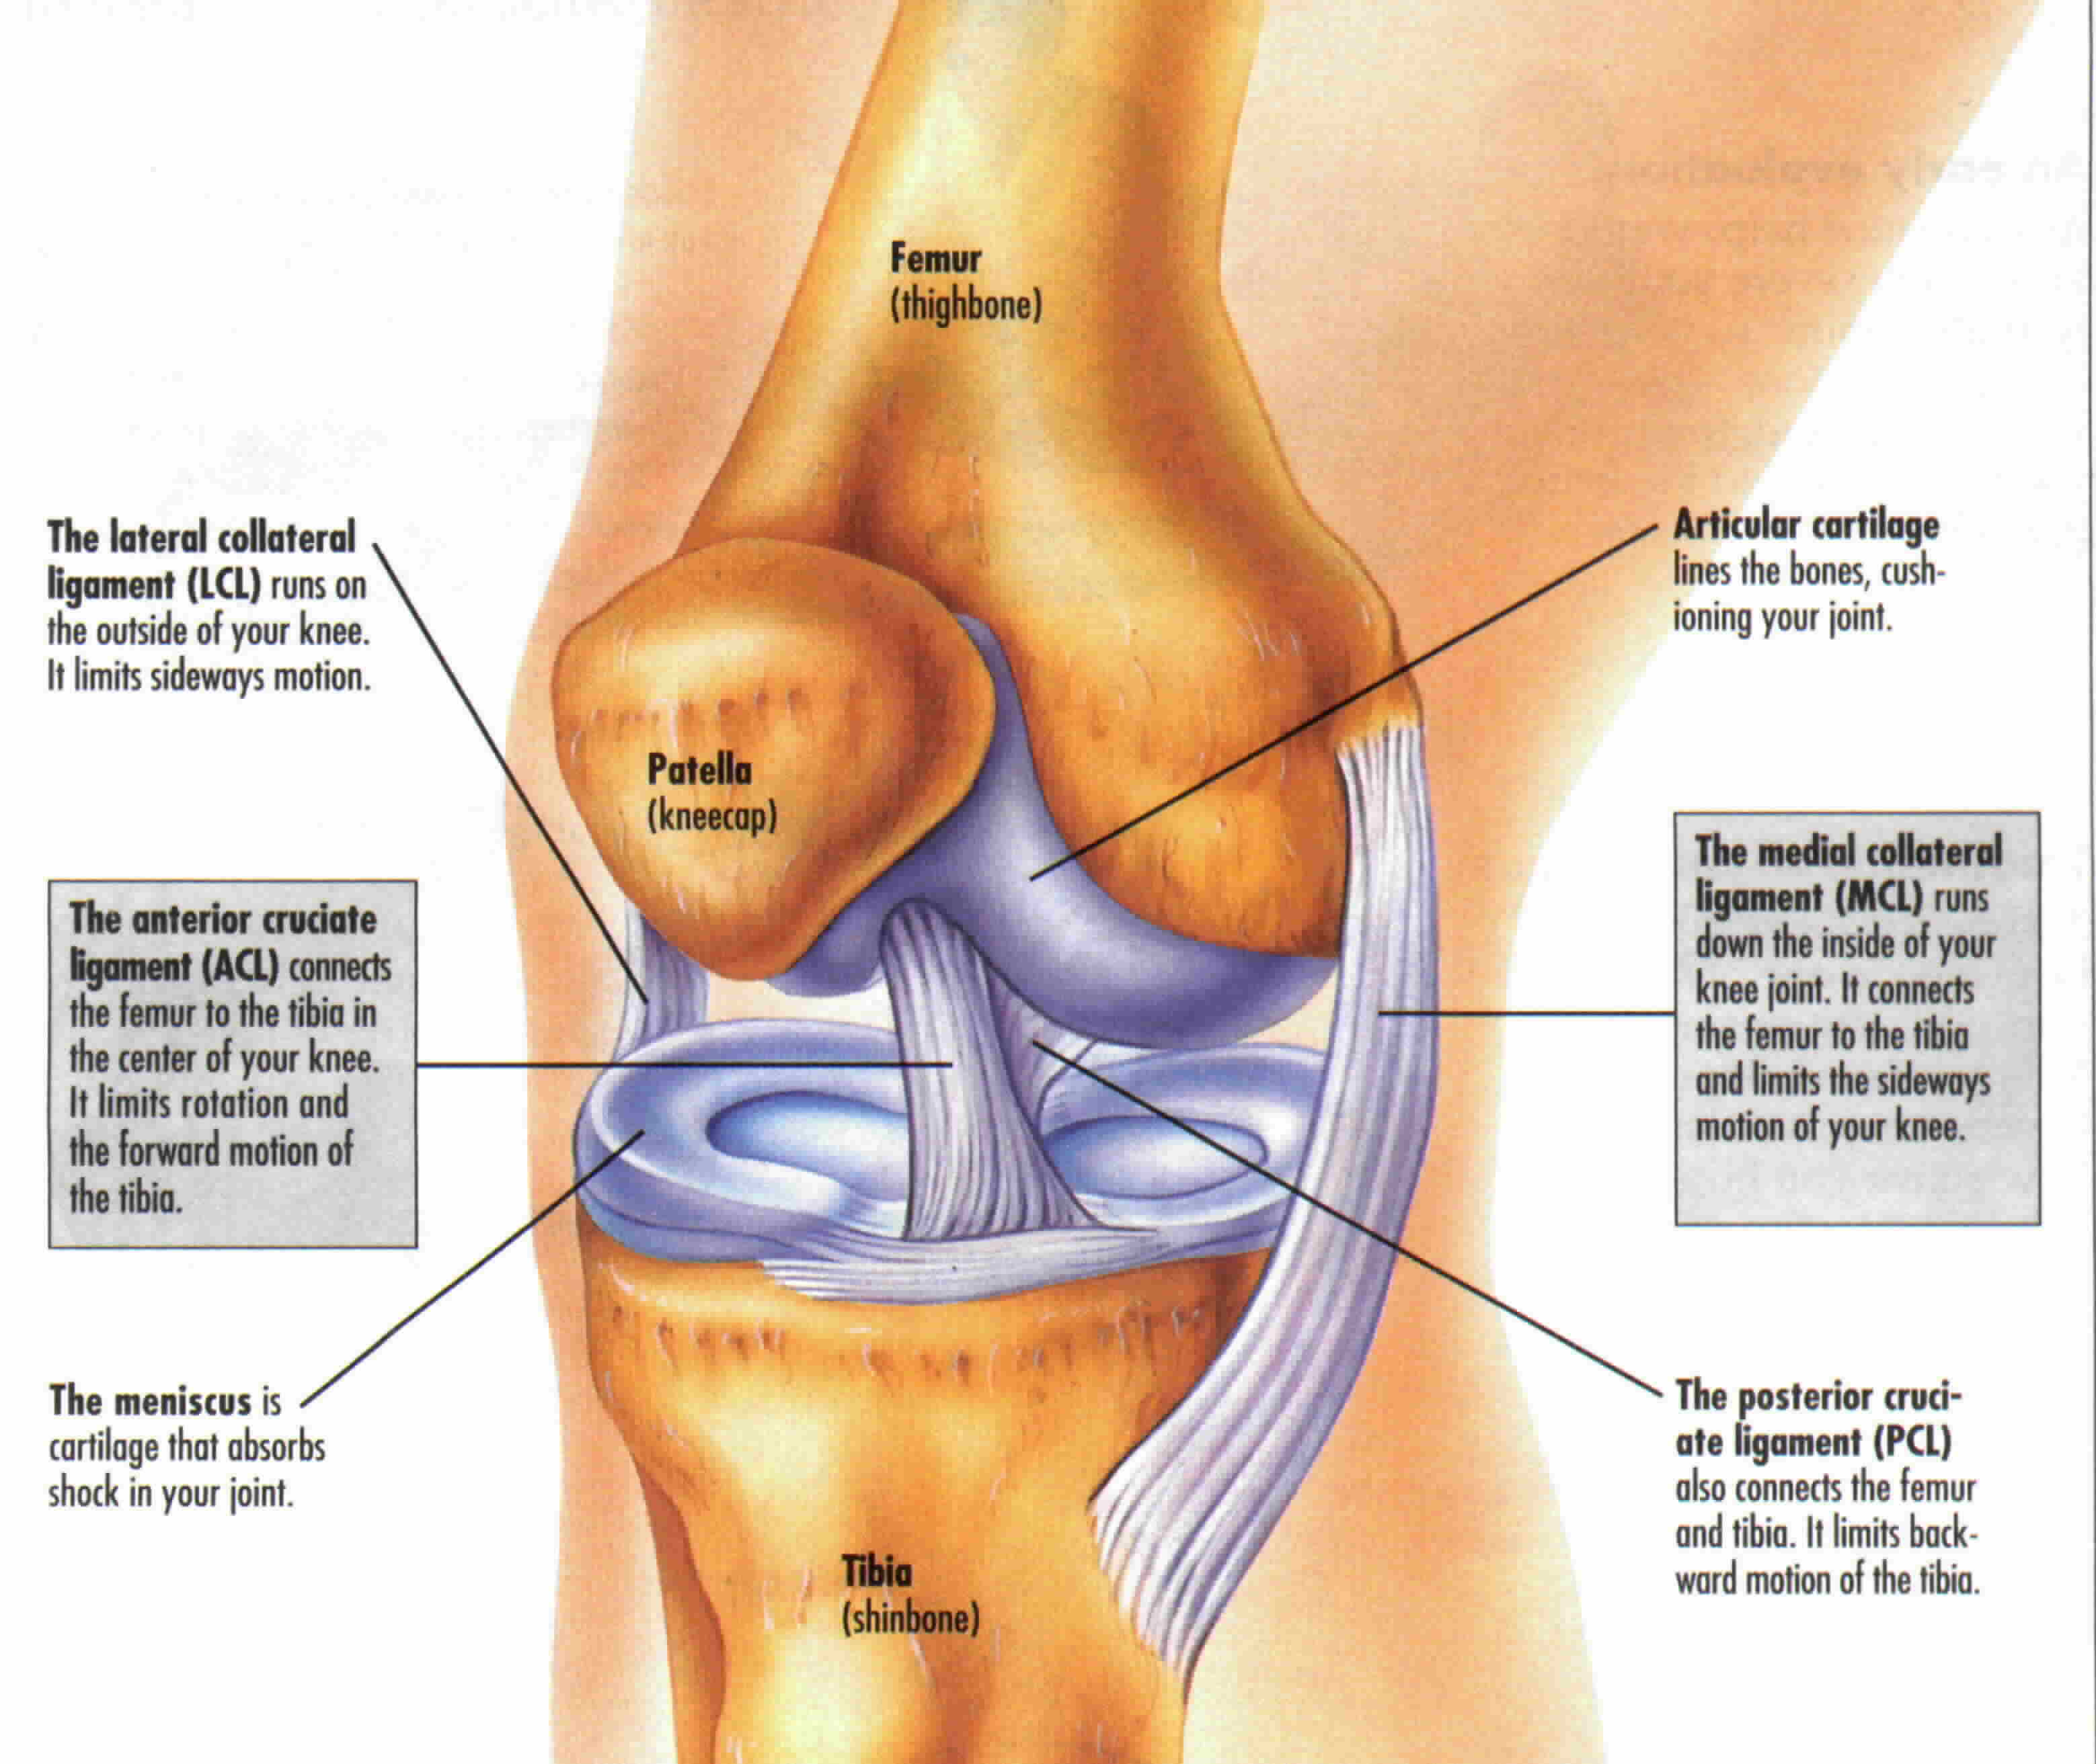
Acute Injuries in Gymnasts
ACL Tear
Mechanism: Twisting of knee while foot is planted or from hyperextension of knee with foot planted
Swelling around knee, instability, knee gives out with twisting motions
Typically requires surgical repair and a 4-6 month recovery

Slide 9
Acute Injuries in Gymnasts
Meniscus Tear
Mechanism: Twisting of knee while knee is bent or extended
Locking, catching, inability to extend or bend fully
May require surgery to repair it or remove the part that is torn

Slide 10
Acute Injuries in Gymnasts
Patellar Subluxation
Mechanism: Pivoting, twisting, or quick change of direction
Feeling of instability
Pain on either side of the kneecap
May need to be relocated (dislocation)

Slide 11
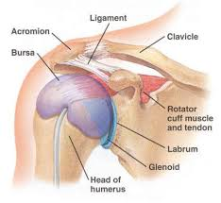
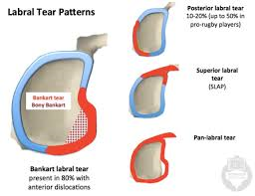
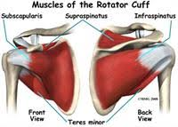
Acute Injuries in Gymnasts
Shoulder Subluxation/Dislocation
Mechanism: Fall onto outstretched arm, twisting in a weight bearing position
May involve a tear of the rotator cuff or labrum (cartilage)
Symptoms: Instability, numbness, weakness, restricted range of motion overhead
May require surgery if the problem becomes chronic

Slide 12
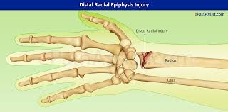
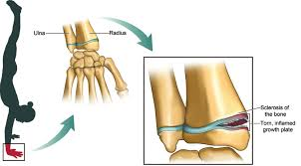
Acute Injuries in Gymnasts
Distal Radius Growth Plate Fracture
Mechanism: Fall onto outstretched hand, repeated stress to the growth plate during weight bearing causing undergrowth of the radius
Symptoms: Impaired ability to bear weight on hand, localized pain along radial (thumb-side) of wrist, reduced ROM

Slide 13
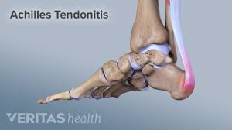
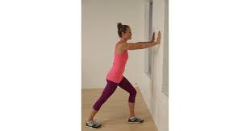
Chronic Gymnastics Injuries
Achilles Tendonitis
Strain of the Achilles tendon at its insertion into the heel
Caused by repetitive jumping, sudden starts and stops, overuse
Chronic inflammation can lead to changes in the tendon making it less flexible and weaker
Symptoms:
Pain with swelling over tendon
Stiff and painful after activity
Stiff in the morning
Treatment: Calf stretching, eccentric loading

Slide 14
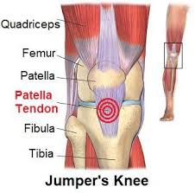
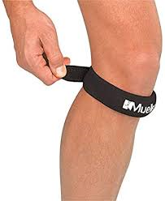
Chronic Injuries in Gymnasts
Patellar tendinitis – “Jumper’s knee”
Pain below kneecap with jumping and deep squatting
Causes: Overuse, poor alignment, poor knee control, muscle imbalances
Treatment: Quadriceps stretching, hip and quadriceps strengthening, focus on good alignment, ice/ice massage
May use a Chopat strap or pre-wrap strap

Slide 15
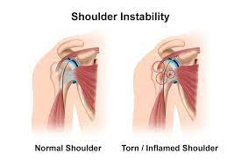
Chronic Injuries in Gymnasts
Shoulder Instability
Laxity (increased mobility) of shoulder ligaments can cause too much motion in the shoulder
Gymnasts often challenge end range shoulder flexibility to perform high level skills but lack stability to support body weight in those positions
May have clicking, popping and/or pain
Treatment will include rotator cuff and scapular muscle strengthening

Slide 16
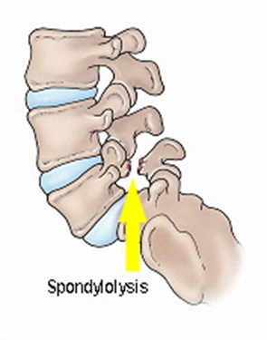
Chronic Injuries in Gymnasts
Spondylolysis
Result of high pressures in a hyperextended position (extension & rotation)
Repetitive injury leads to a stress fracture
Common presentation: Low back pain, buttock pain, posterior thigh pain
Treatment: Gluteal/core strengthening, improve hip flexibility, improve postural awareness
Important to understand that a “stress reaction” is the gymnast’s warning sign

Slide 17
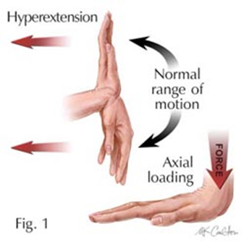
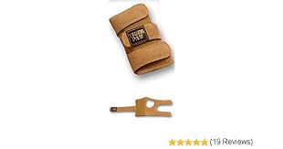
Chronic Injuries in Gymnasts
Gymnast’s Wrist
Distal Radial Physeal Stress Syndrome
Inflammation at the growth plate of the distal radius from repetitive weight bearing at the wrist
May lead to a premature closure of the growth plate
Symptoms: Pain, swelling, tenderness at the wrist on the thumb side, reduced strength
Treatment: Modify training intensity, wrist strengthening, use of wrist guards

Slide 18
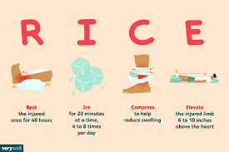
Acute Injury Management
Rest
Ice
Compression
Elevation
Ice should only be applied for 15-20 minutes at a time, 4-5x/day.
Place a paper towel or cloth between cold pack and skin to avoid frostbite
Will need to warm-up again if icing in the middle of practice
Pain-free ROM should be restored before returning to activity

Slide 19
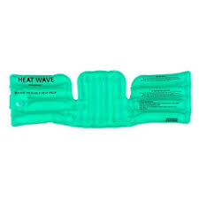
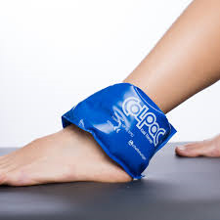
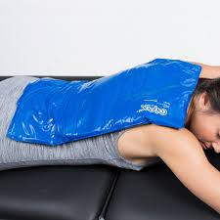
Ice or Heat???
Heat to warm-up or loosen tight muscles
Sore neck or back muscles
No more than 10-15 minutes
Never over a swollen area
Ice for acute injuries or after activity to prevent soreness or lessen swelling
Never before activity
Always need to warm up again if returning to activity
No more than 15-20 minutes at a time
Never tape over cold or numb skin

Slide 20
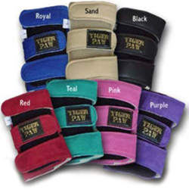
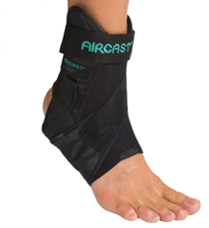
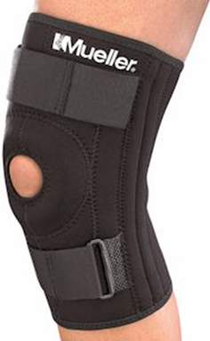
Use of Braces
Can help to reduce the stress on a joint, provide extra stability, or provide compression
Often used when returning from an injury
Not an excuse to push through a chronic injury
Long-term use can lead to weakening of the muscles around the joint and decreased proprioception
Need a strengthening program for that joint/area

Slide 21
How to Prepare for Upcoming Competition Season
General Tips
Proper warm-up
Incorporate injury prevention exercises into conditioning program
Prevent overuse of a particular area
Pay attention to common complaints/trends in your group
Proper progression with training basic skills before moving on to higher level skills
Work on landing drills (forward, backward, single leg)
Address any painful areas promptly—Free Assessment

Slide 22
Common Areas of Injury in Male Gymnasts
Wrist and hand
Shoulder
Ankle
Knee
Lower back

Slide 23
Upper Body Exercises
Push-ups
Push-ups with hands or feet on a block
Blocking push-ups (on knees first, then full body)
Rotator cuff
Internal rotation with Theraband
External rotation: Theraband or dumbbell
Scapular muscles
Rows
Extension
Flys
Y’s and T’s in quadruped
Wrist
Flexion (curl)
Extension
Flexbar

Slide 24
Lower Body Exercises
Lateral band walk
Chair/block squat
Sidelying abduction at the wall
Panel mat step downs
3 way heel taps (front, side, back)
Heel raises
Double and single leg
Diagonal with hands on wall

Slide 25
Core Exercises
Bridges
Marching
Figure 4
Planks
Front or side
On elbows or arms straight
Side plank with clam
Single leg exercises
Eyes closed
Dead lift/airplane

Slide 26
Flexibility Considerations
Dynamic warm-up: Jogging, skipping, high knees, arm circles, trunk twists, inchworms
Flexibility
Static stretching (i.e. splits, straddle, pike)
No bouncing
Work on both sides equally
Avoid pushing your athletes into their stretches – may lead to injury
Oversplits – should not be used if athlete does not have a full split on the ground

Slide 27
Flexibility Considerations
Common stretches
Hamstrings
Kneeling hip flexor stretch
Piriformis
Lat stretch with elbows on block
Gastroc/soleus stretch at wall
Wrist flexion/extension
Foam rolling
Quads, hamstrings, IT bands, upper back, lats, pec stretch

Slide 28
When to see a Health Professional
Pain that has occurred for 1-2 weeks that is not improving with rest and heat/ice
Joint pain, loss of range of motion, swelling, inability to bear weight
Concussion symptoms
Free Assessment at Athletico
Scheduled within 24-48 hours
Early/late appointments, Saturdays 7 a.m.-12 p.m.
Injury assessment, provide exercises to get you started
Assist with referral to a physician who understands gymnastics if needed
Direct Access: Can start PT/OT right away after your assessment if allowed by your insurance

Slide 29
Summary
Be aware of common acute and chronic injuries and recommend referral to an AT/PT/OT or MD for help
Correctly use ice and heat for injury management
Conditioning is not punishment—make it functional, incorporate exercises to address all key areas, pay attention to form and level of fatigue
Add injury prevention exercises into your practices
Incorporate safe stretching techniques
When in doubt, reach out to Athletico’s Gymnastics and Cheerleading Program clinicians for help in your area

Slide 30
Rachel Quick, PT, DPT, OCS
Clinic Manager, Physical Therapist
Athletico Lake Zurich
Gymnastics & Cheerleading Program Participant
260-570-6633
847-438-6624
Rachel.quick
@athletico.com
athletico.com

Slide 31
THANK YOU!

